Slide 1


Locating Suitable Locations
FOR EV CHARGING POINTS

Slide 2
Introduction
There are challenges in coming up with suitable Electrical Vehicle (EV) Charging Point locations in Singapore which is land scarce and high density.
An alternative strategy to charging while EV drivers sleep, could be charging while EV drivers wait, by spending their time meaningfully by engaging in activities in nearby locations around these EV carparks.
The optimal distribution of EV charging points is important as perceived lack of convenience for potential EV drivers based on a regular routine around where they travel or live, could affect the perception of EVs as a viable and convenient alternative to internal combustion engine (ICE) cars.

Slide 3
A Closer Look at the Supply of Existing Carparks

Slide 4
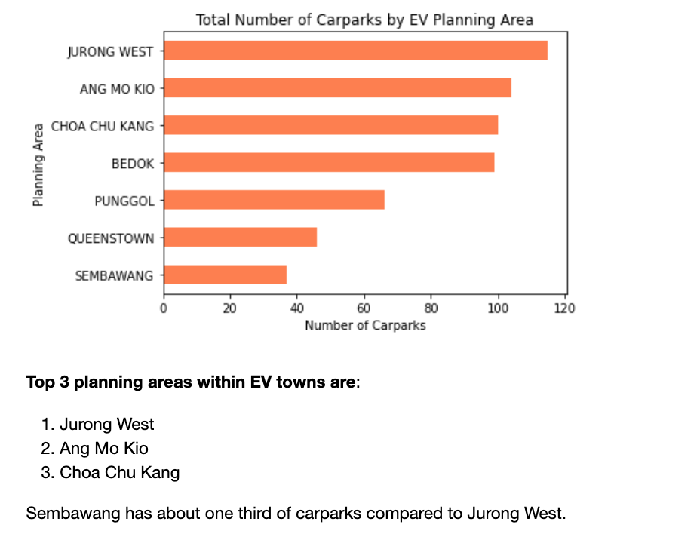
You are
3 times more likely to see a carpark in
Jurong West than Sembawang

Slide 5
Potential Factors Affecting the Demand for EV Carparks

Slide 6
Data Analysis
To locate the Planning Areas where EV Charging Points are most needed by drivers and potential drivers of EVs, we will be looking at areas with the most number of HDB dwelling units as well as employed residents who travel to work by car only, taking into account both their workplace and residential areas.
Planning Areas will also be analyzed by looking at demographics such as age range which could inform on the likelihood of these areas having current and potential EV car drivers.

Slide 7
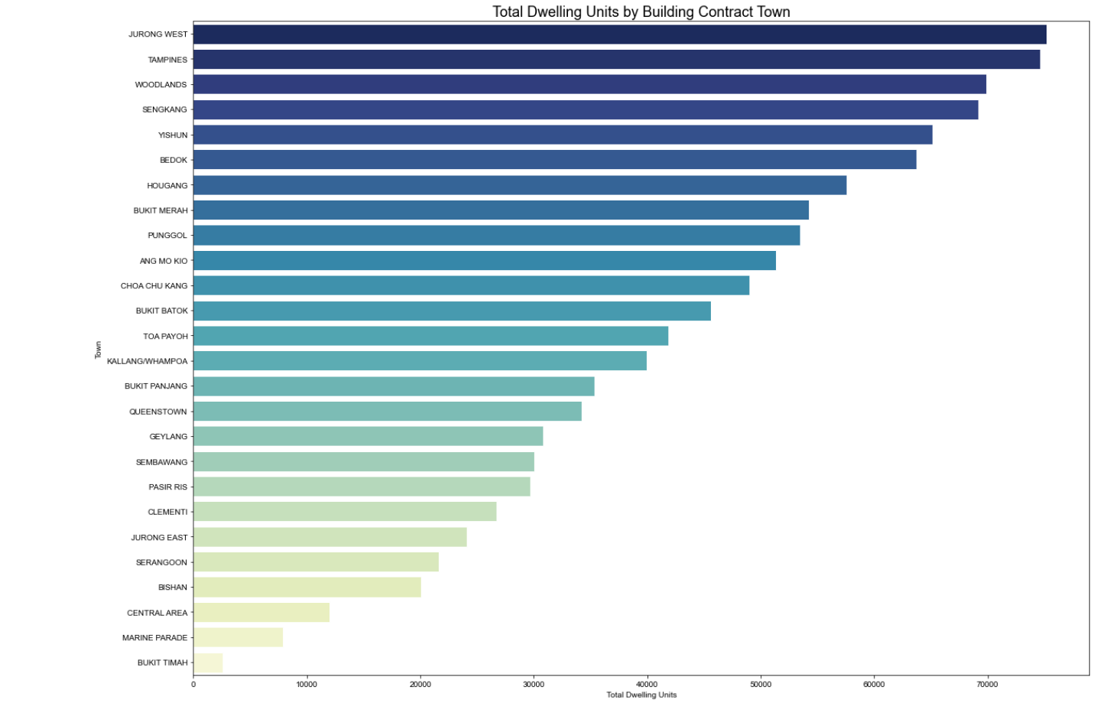
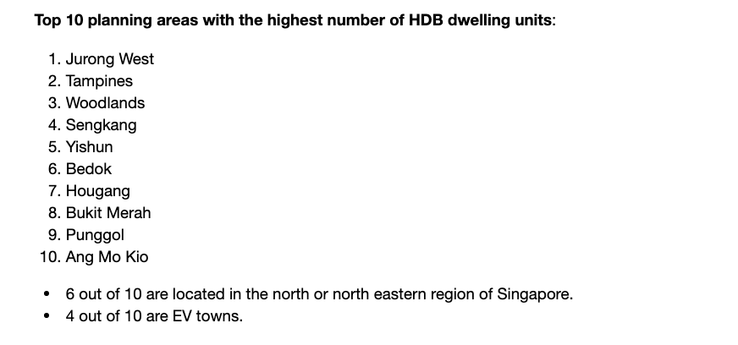
Among Top 10 Towns with highest number of HDB units , only 4 will be EV Towns

Slide 8
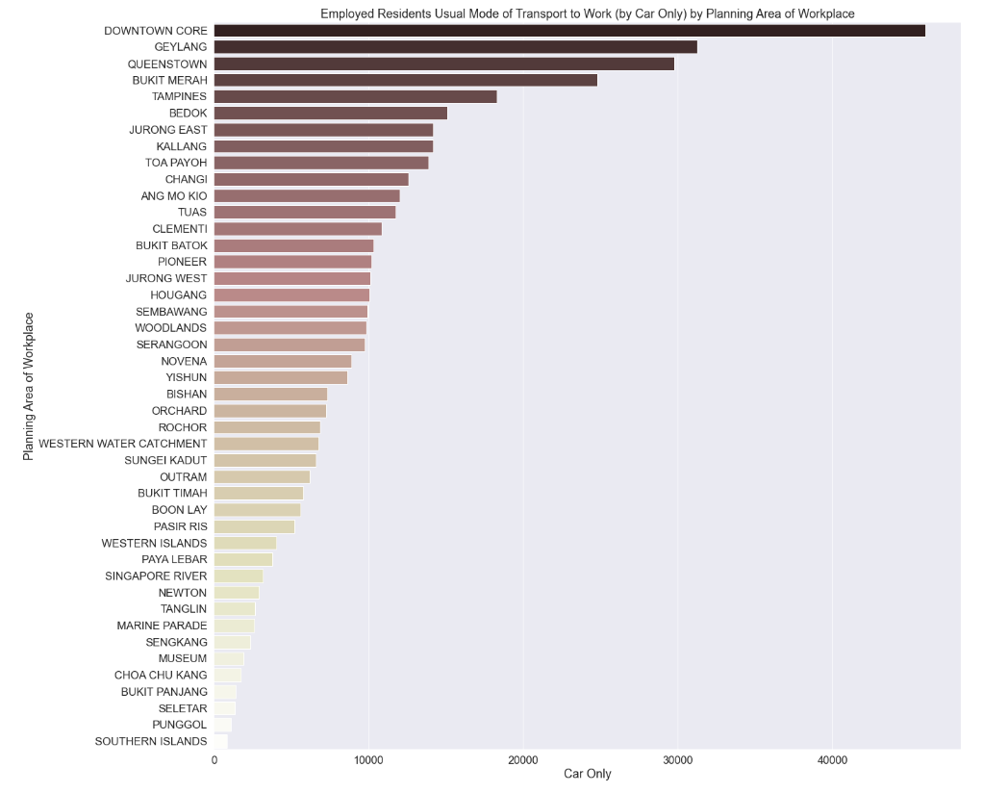
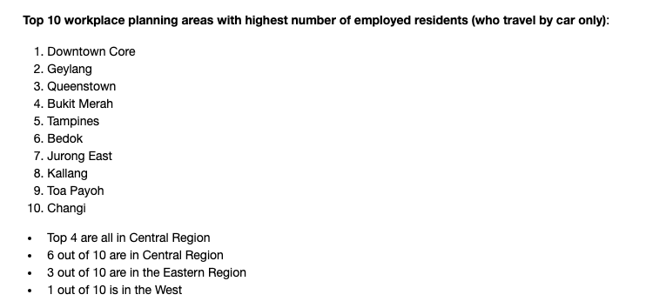
Most People Who Travel by Car to Work, also Work in the Central Region …

Slide 9


But only 1 in 8 EV Towns is in the Central Region

Slide 10
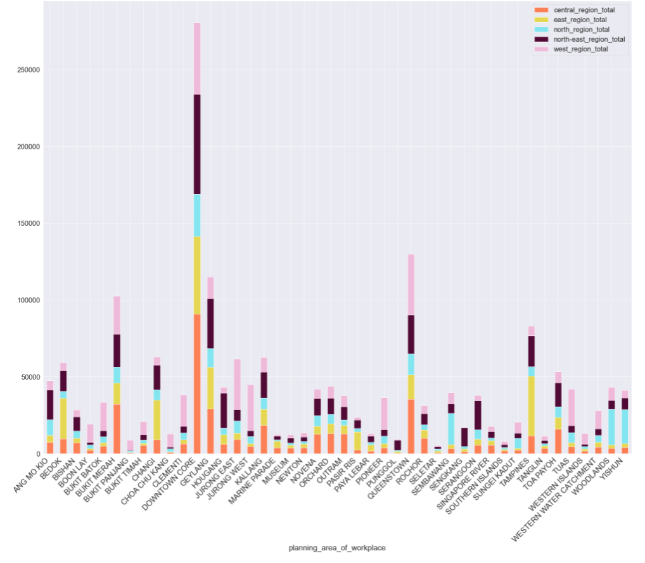
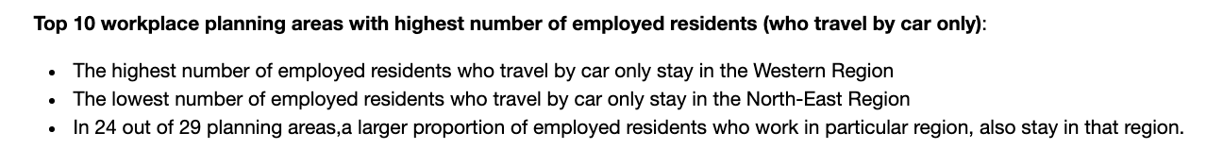
Employed Residents Tend to Work and Stay in Same Region
Lower range anxiety?

Slide 11
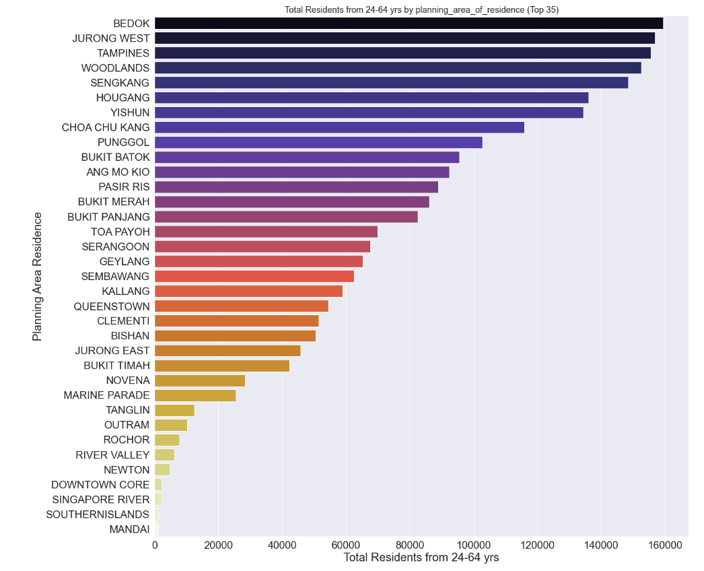
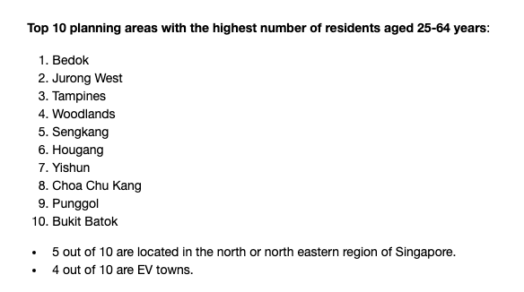
The Most Number of Residents Can Be Found in Bedok, Jurong West & Tampines

Slide 12
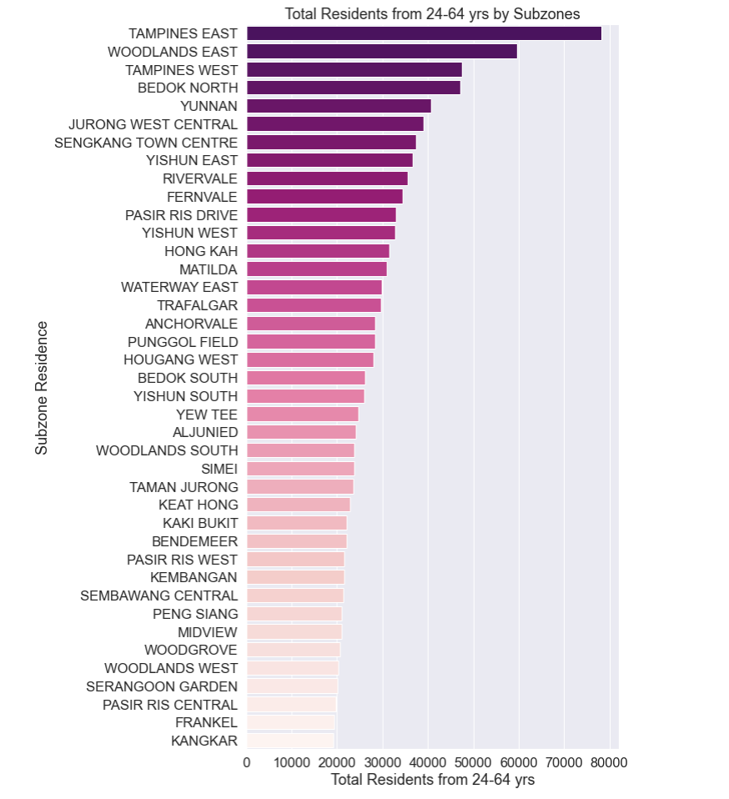
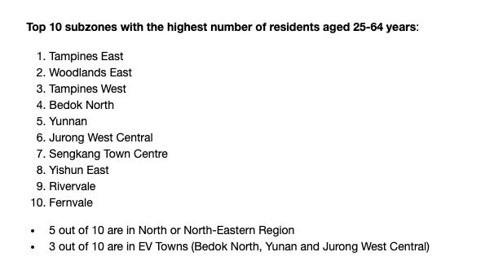
Potential Future EV Towns?

Slide 13
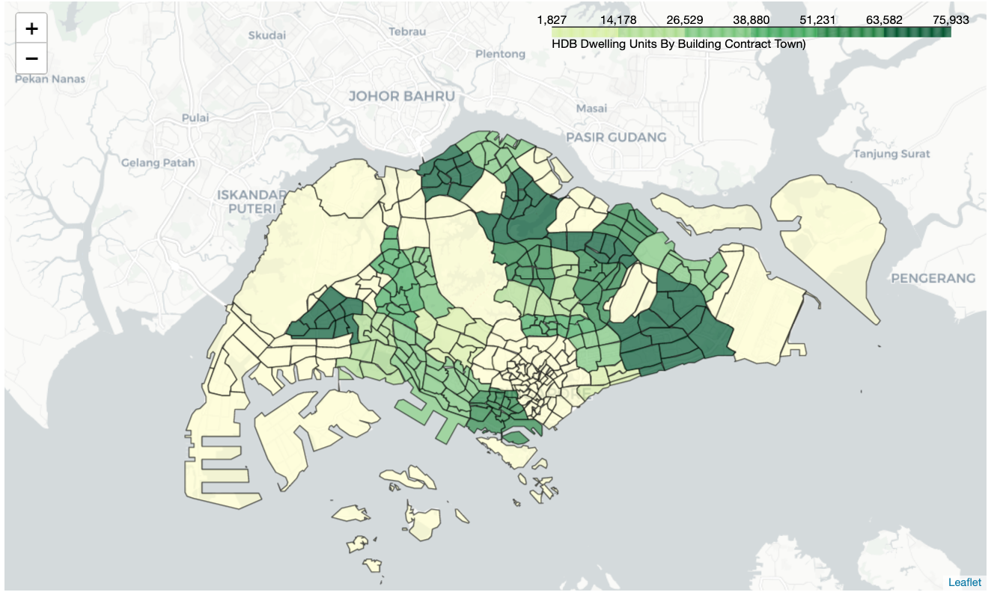
Highest Number of Housing Units in North and
North East

Slide 14
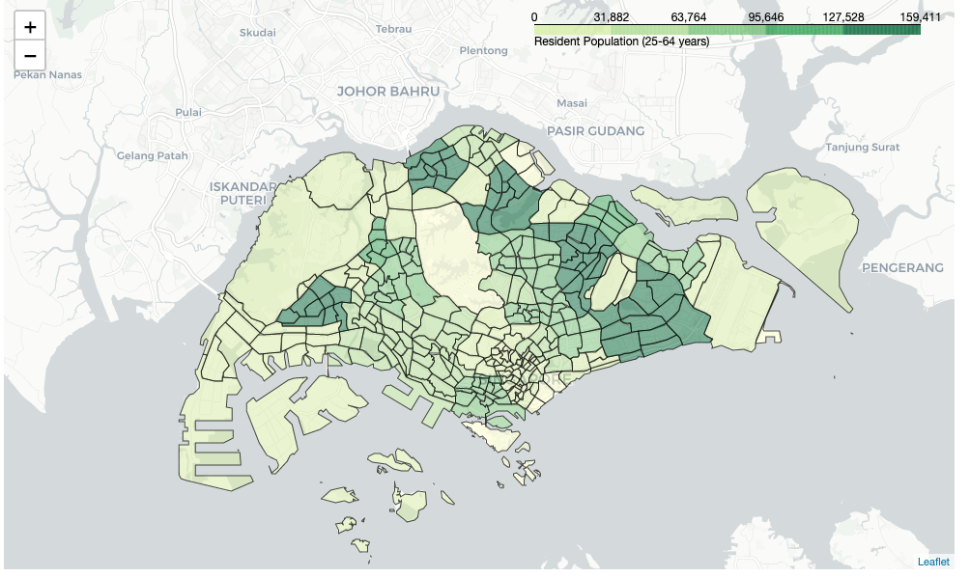
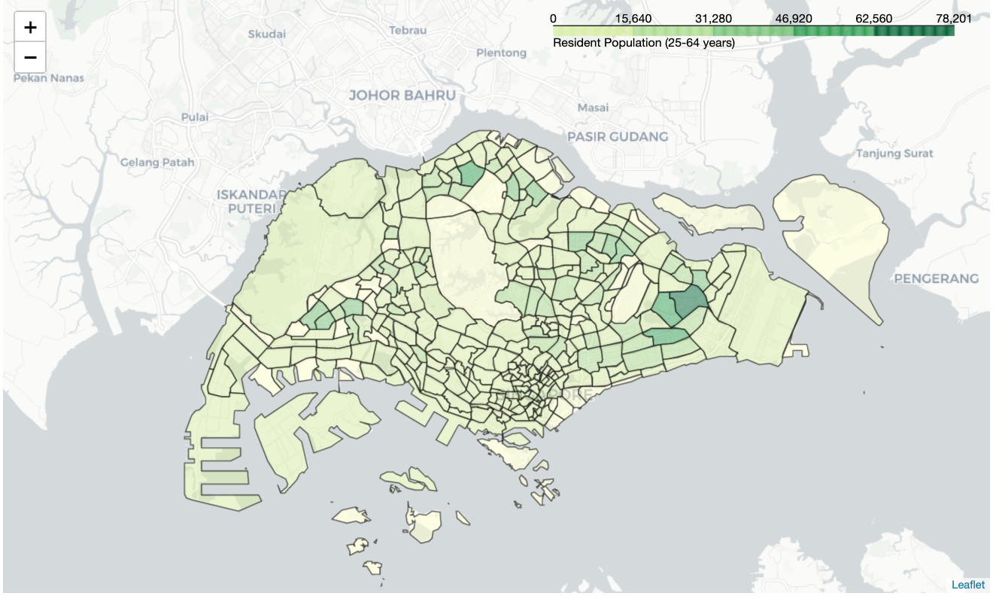
Potential Demand for EV Charging by Highly Populated North and North Eastern Planning Areas?

Slide 15
Visualization of Distribution of HDB Carparks across Singapore and in EV Towns

Slide 16
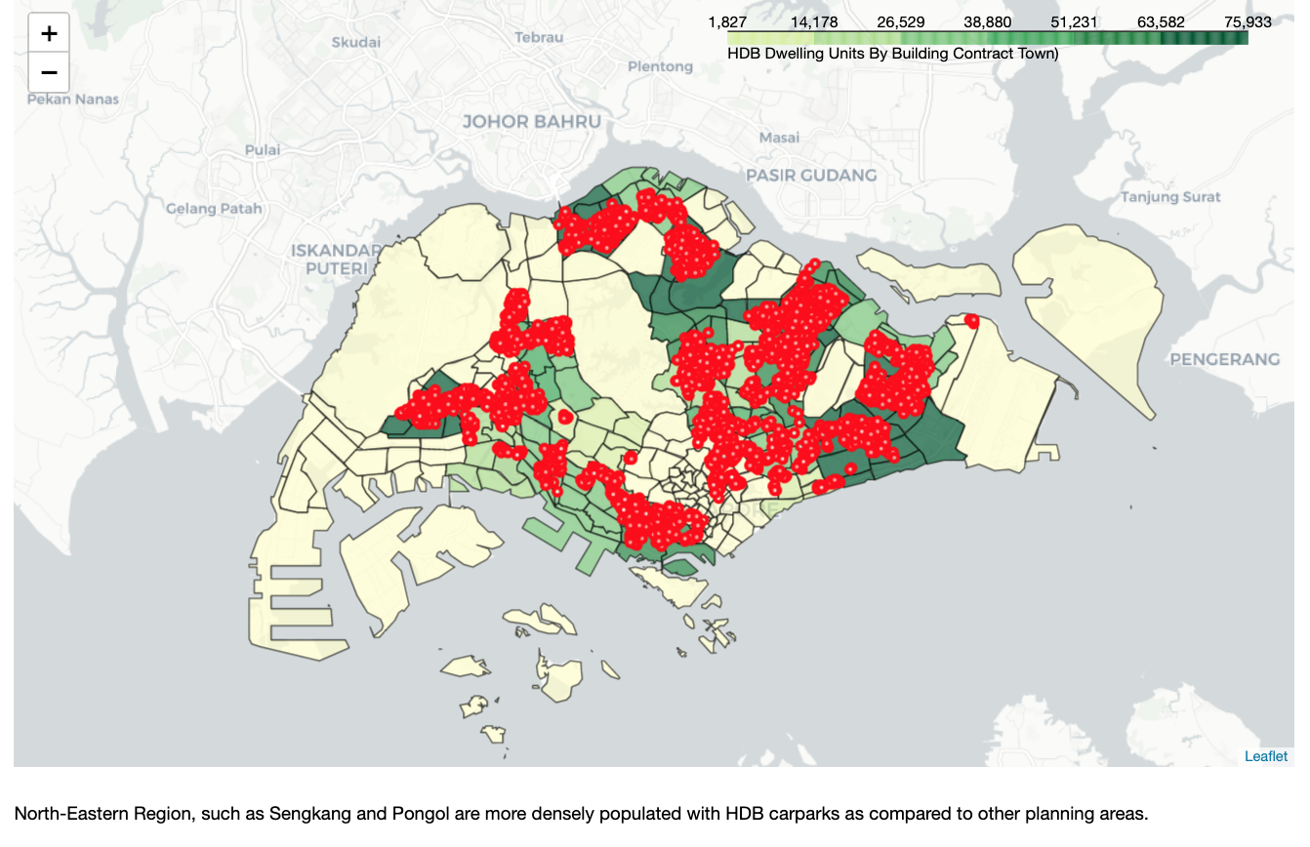

Slide 17

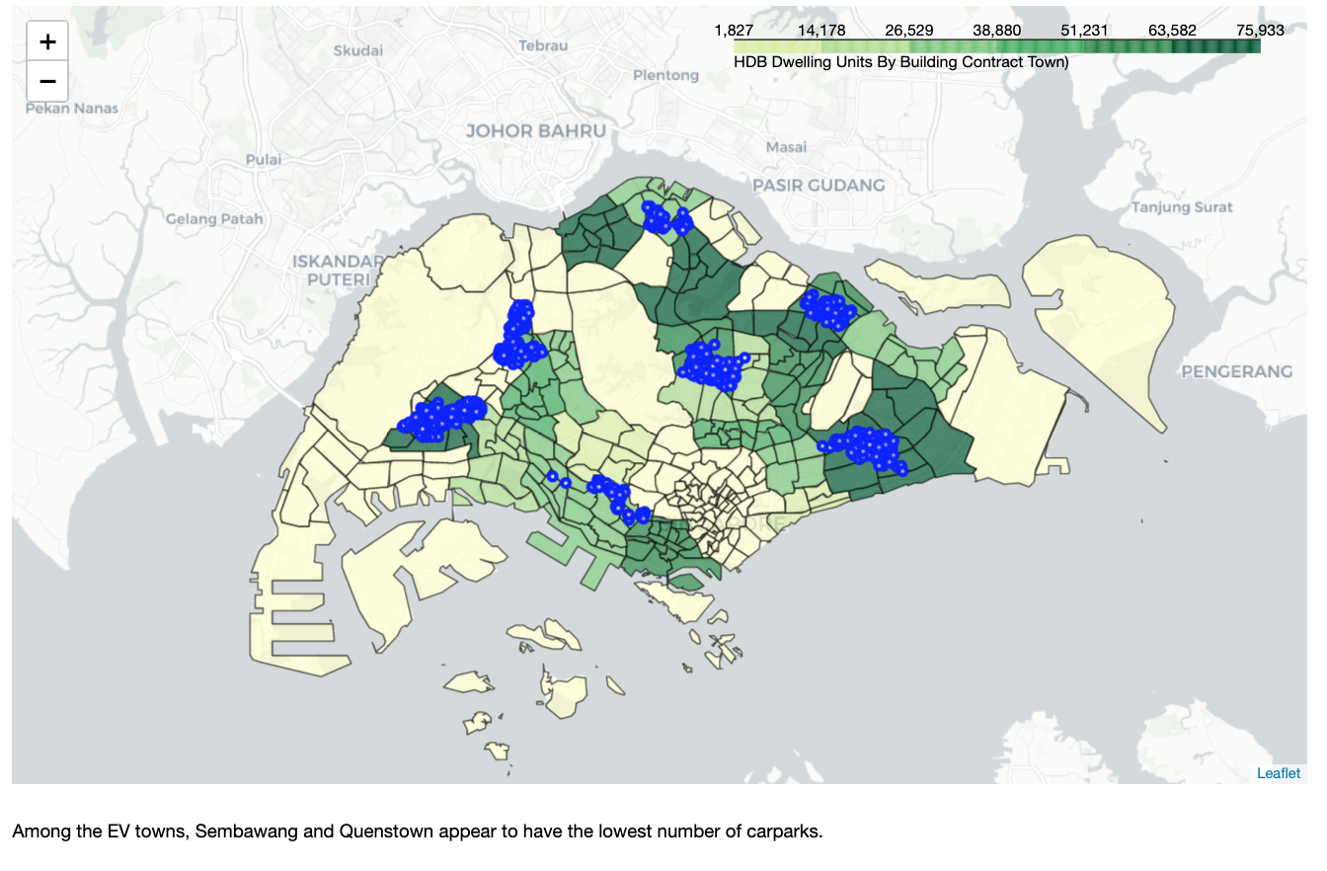

Slide 18
Visualization of Distribution of Carparks across Singapore along with nearby venues scraped from Foursquare API.

Slide 19
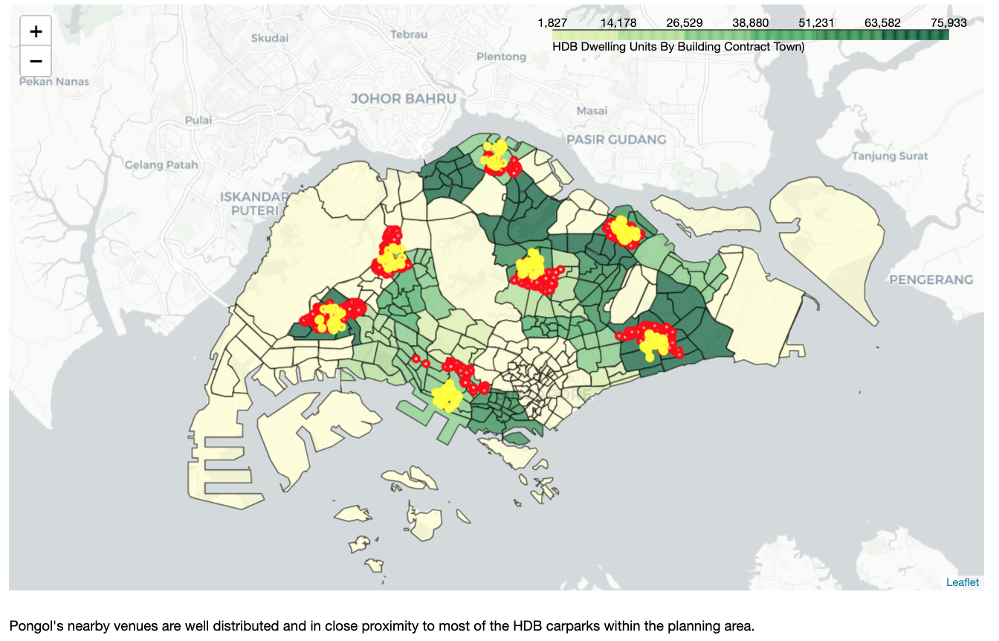

Slide 20
Clustering Planning Areas into 5 Clusters Using KMeans and with the Top 10 Venues for Each EV Town

Slide 21
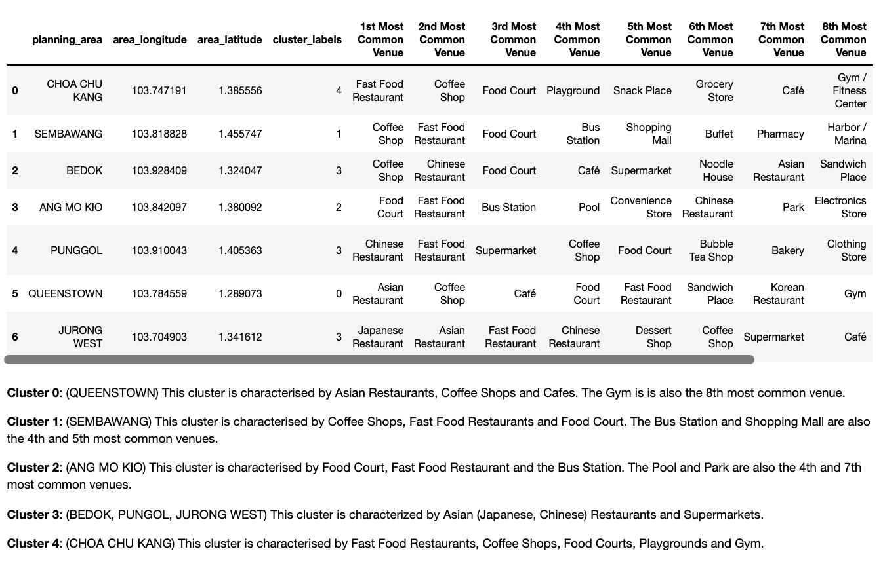

Slide 22
Potential Locations for EV carparks

Slide 23
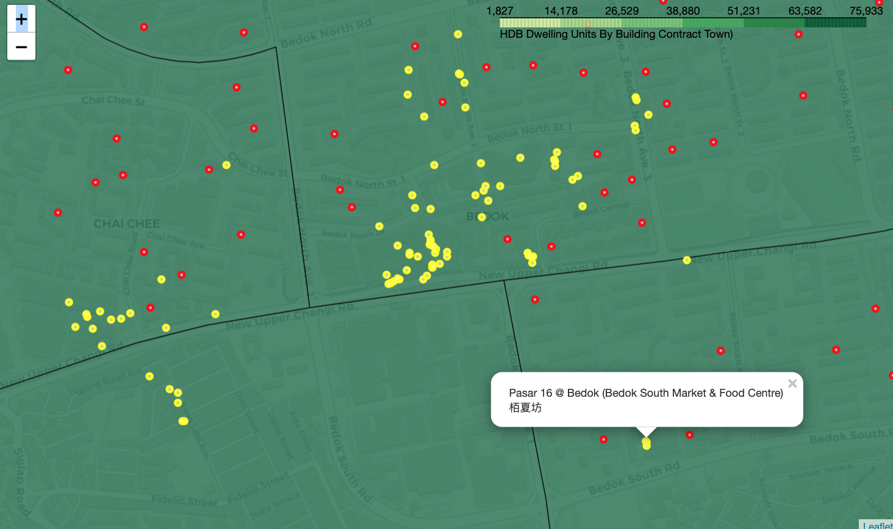
Bedok

Slide 24
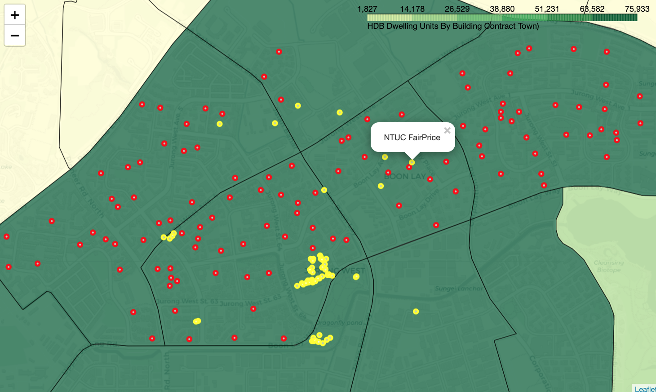
Jurong West

Slide 25
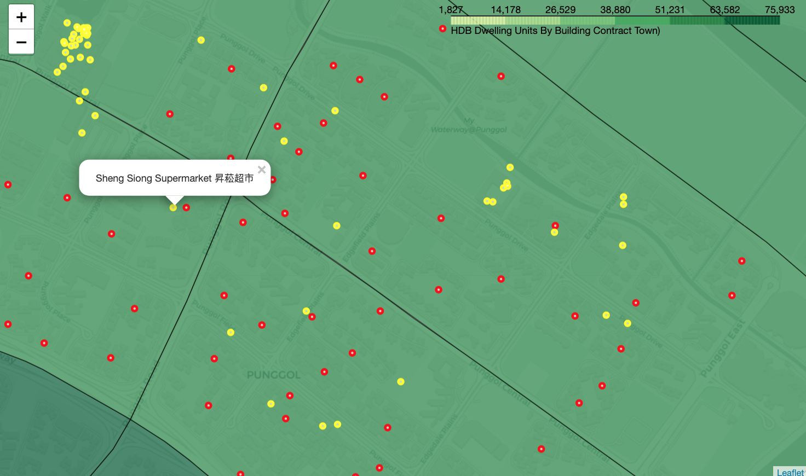
Punggol

Slide 26
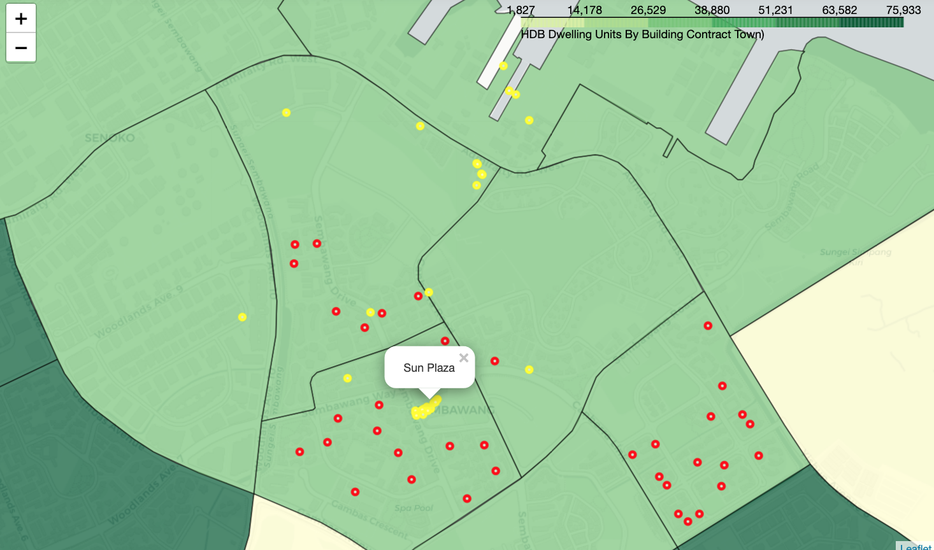
Sembawang

Slide 27
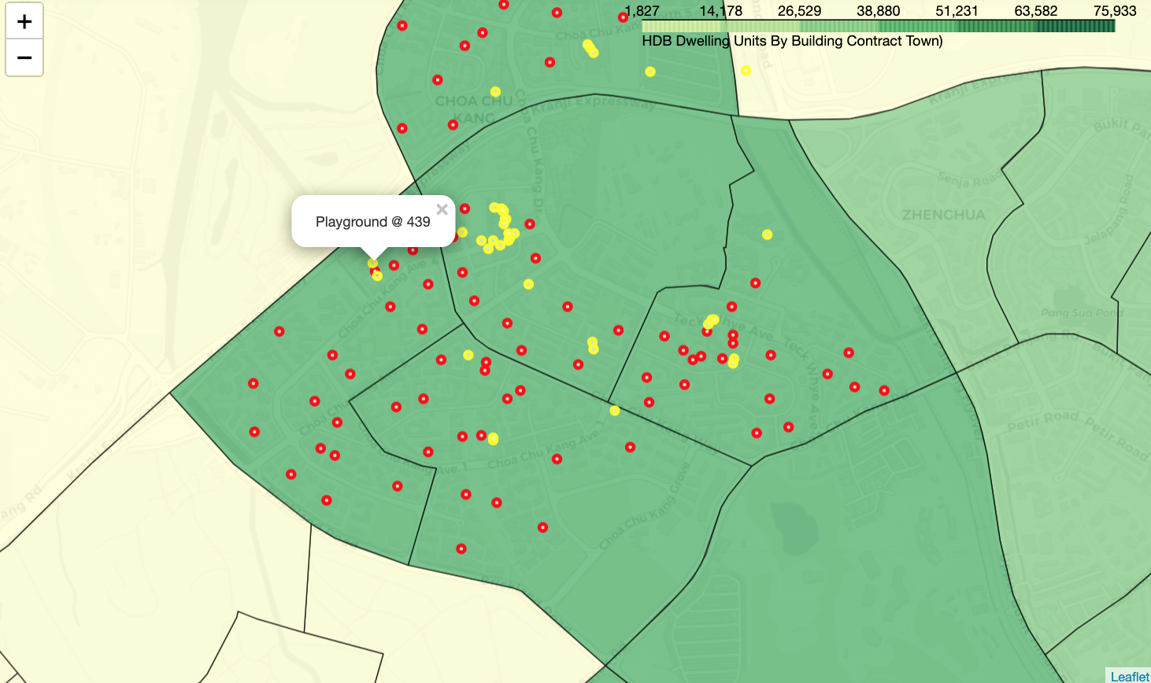
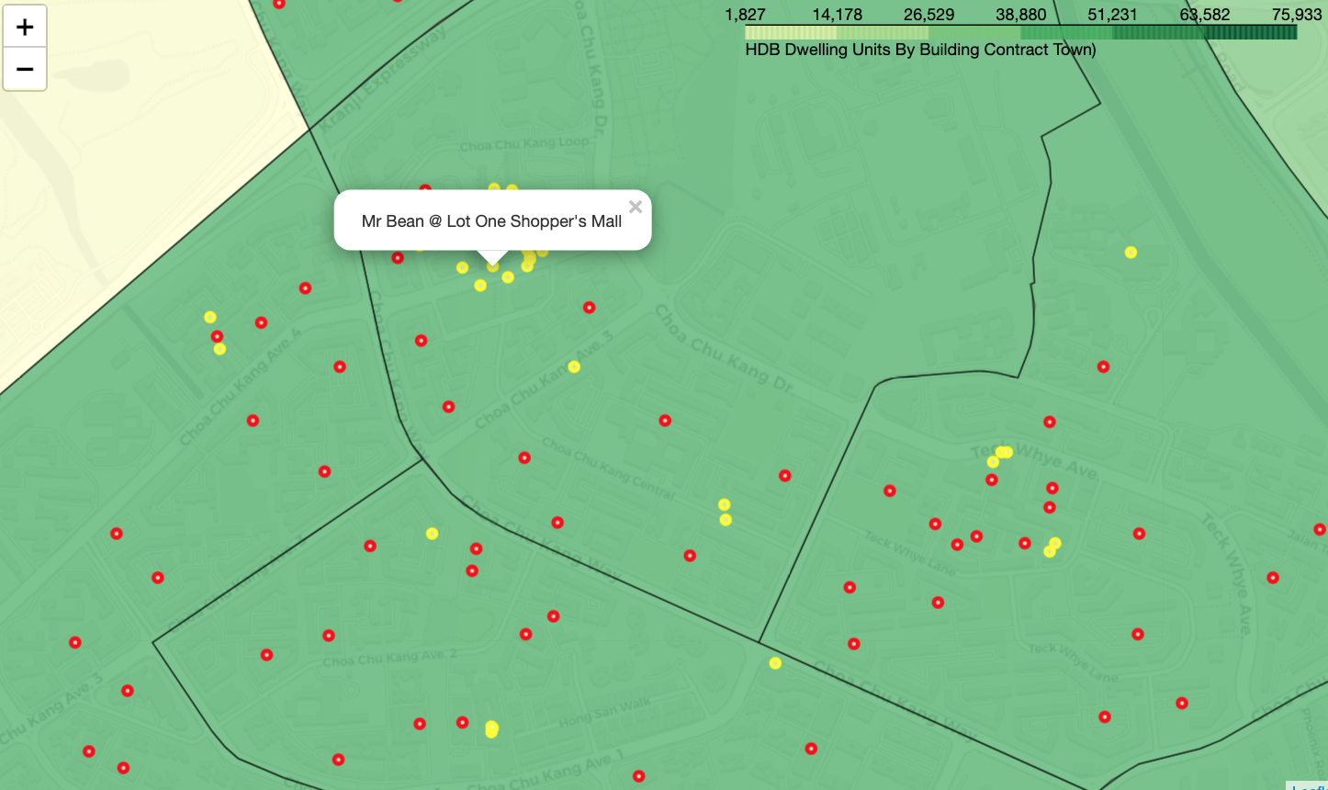
Choa Chu Kang

Slide 28
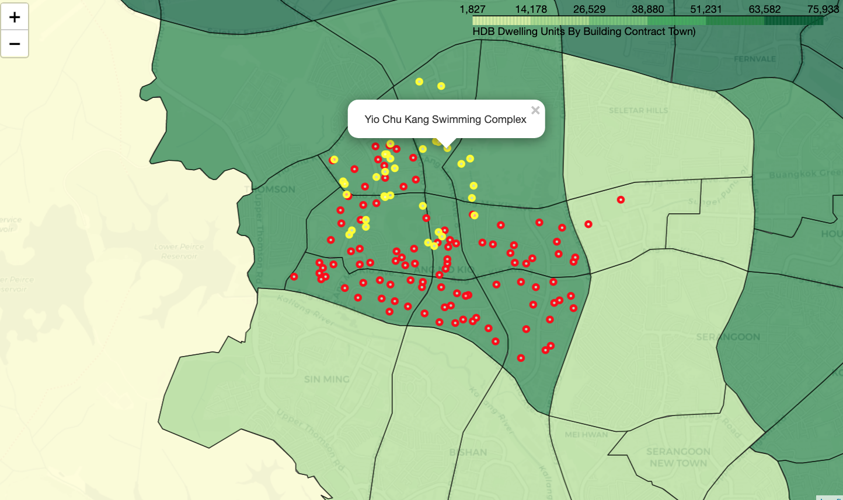
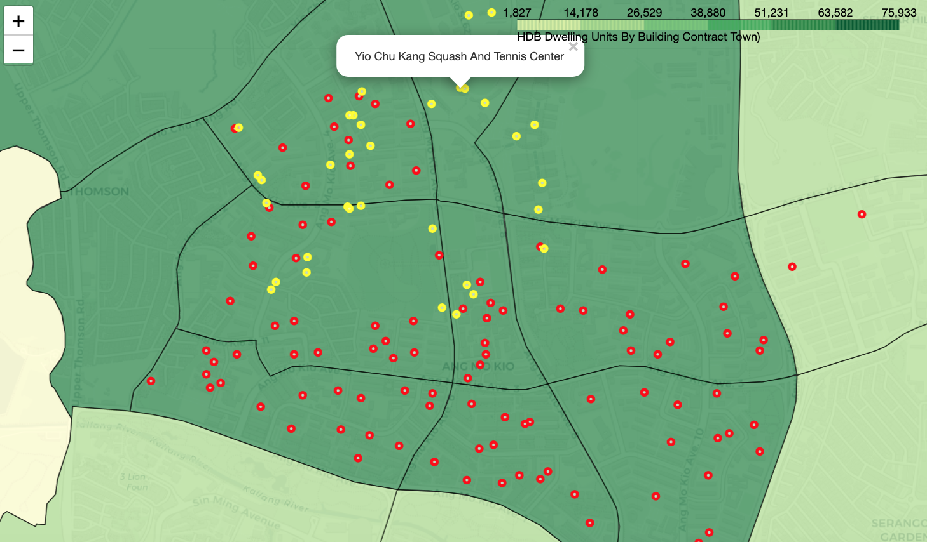
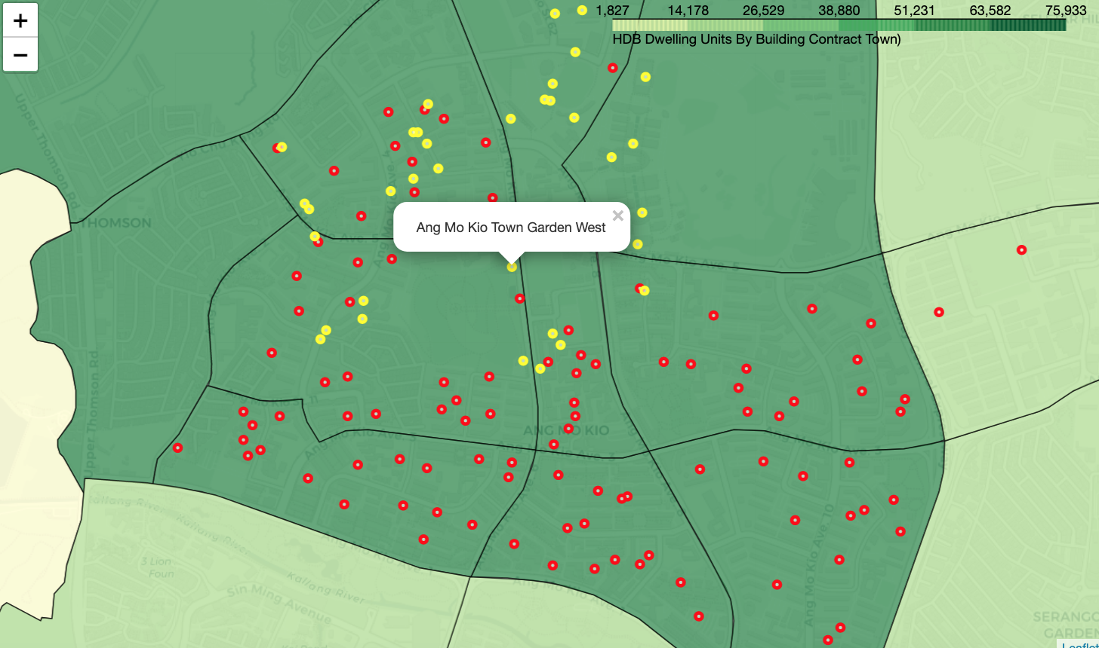
Ang Mo Kio

Slide 29
The End

